Slide 1


Automation for installation of splunk app on Clustered Architecture using Jenkins and Ansible
Presented By:
Dirgh Jani(17IT035)
Prachi Patel(17IT075)

Slide 2
Outline of presentation
Project Description
Objective
Flow Diagram
Tools and Technology
Hardware & Software Specification
Functional Requirement
Non Functional Requirement
Learning Outcome
Further Planning

Slide 3
Project Description
This project is about splunk architecture creation with automation. In which we are going to use terraform for building, changing and versioning infrastructure safely and efficiently. Jenkins pipeline is going to be used for continuous testing and integration of the project by which we would create cluster architecture of Splunk on which we want to install Splunk App. Ansible playbook would is used for containing steps (script) to install the splunk cluster architecture.

Slide 4
Objective
The main aim of the project is to make Splunk cluster architecture creation simple with easy installation and minimum administration using Jenkins, Terraform and Ansible. Main reason behind using automation tool is that it reduces the efforts of implementation and support while deploying a Splunk cluster environment so that anyone could be able to execute advanced task, even without the right knowledge. And also Clustered Architecture would be used to overcome load on one single instance and will become highly available and durable.

Slide 5
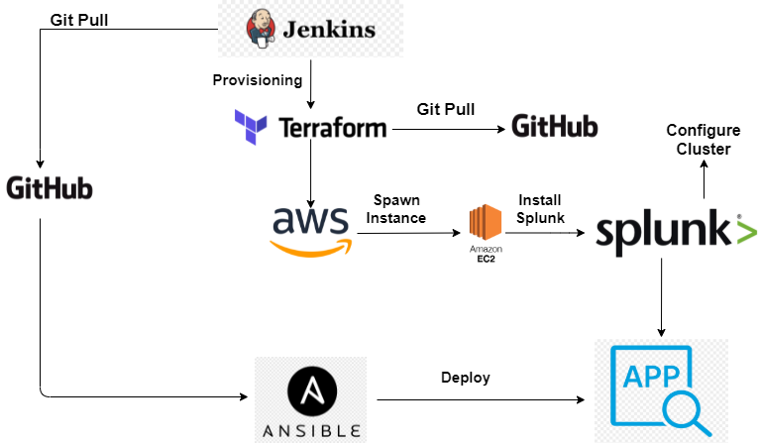
Flow Diagram

Slide 6
Tools and Technology
Splunk
Ansible
Jenkins
Terraform
Amazon Web Services(AWS)

Slide 7
Hardware and Software Specification
Hardware Specification
Minimum 4GB RAM
Minimum 256GB ROM
64-bit Processor
Basic specifications that are compatible for all the softwares requirements
Software Specification
Supported Operating System: Windows, Mac, Linux
Cloud Platform: Amazon Web Services(AWS)
Required Software’s : Splunk Enterprise,Jenkins ,Terraform ,Ansible ,VScode

Slide 8
Functional Requirement
At the end of Jenkins pipeline, a splunk cluster architecture would be setup on AWS platform and app would be installed on top of it using Ansible.

Slide 9
Non Functional Requirement
As we are using AWS as a platform, there would be high availability of the system. Also, inside the cluster we would set up replication and search factor that would replicate the data among instance so it would be easy even in case of instance failure to get data.

Slide 10
Progress of the Project:
We have completed the Infrastructure Setup part of the project. When we trigger the Jenkins Pipeline, The instance get spawned on AWS.
The install of Splunk also gets completed along with Infrastructure Setup.
Clustered Architecture would also be setup on the AWS Instances where splunk was installed.

Slide 11
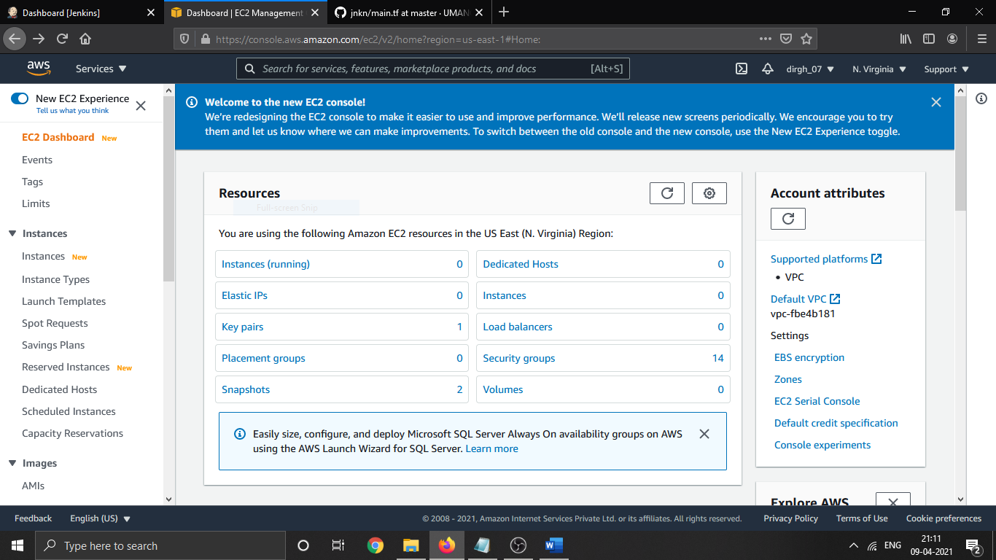
Snapshots of Project:
Initially,
0 running instance on AWS

Slide 12
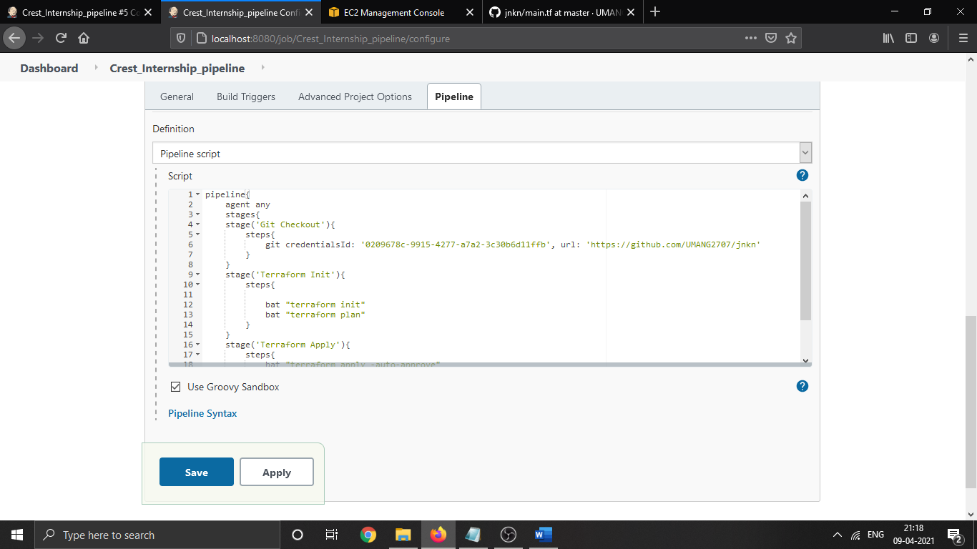
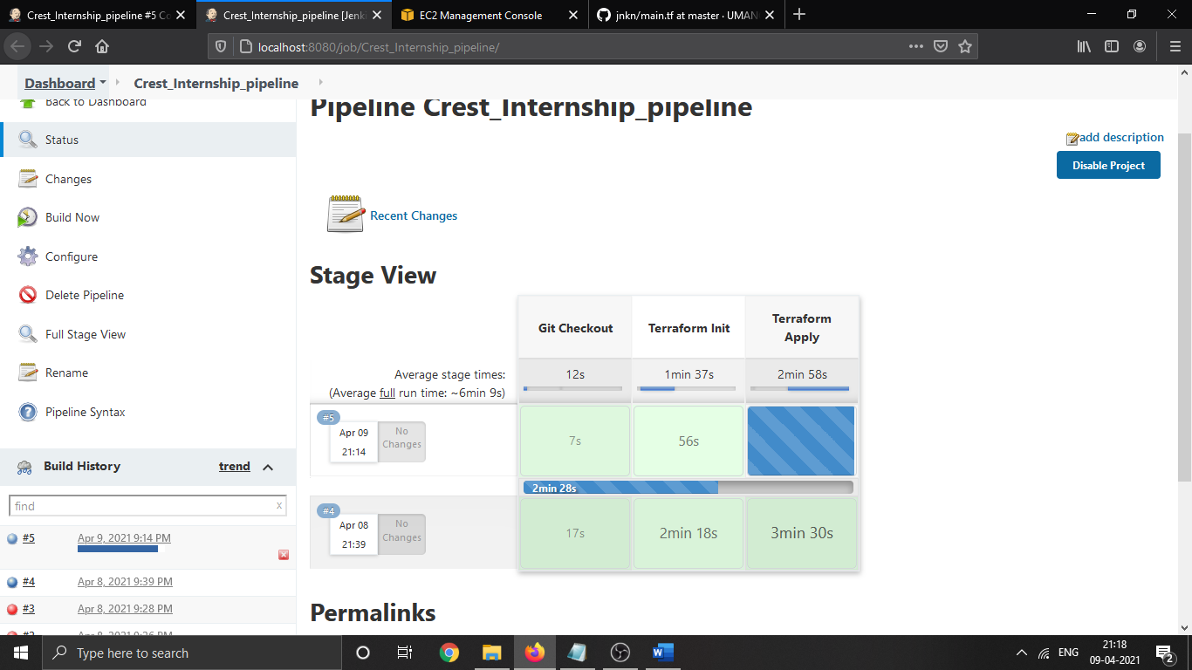
Configured stages inJenkins Pipeline
Triggered Jenkins Pipeline

Slide 13
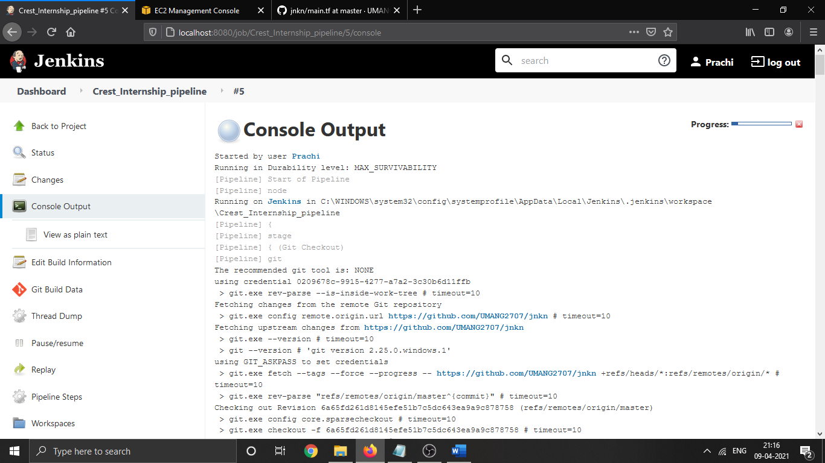
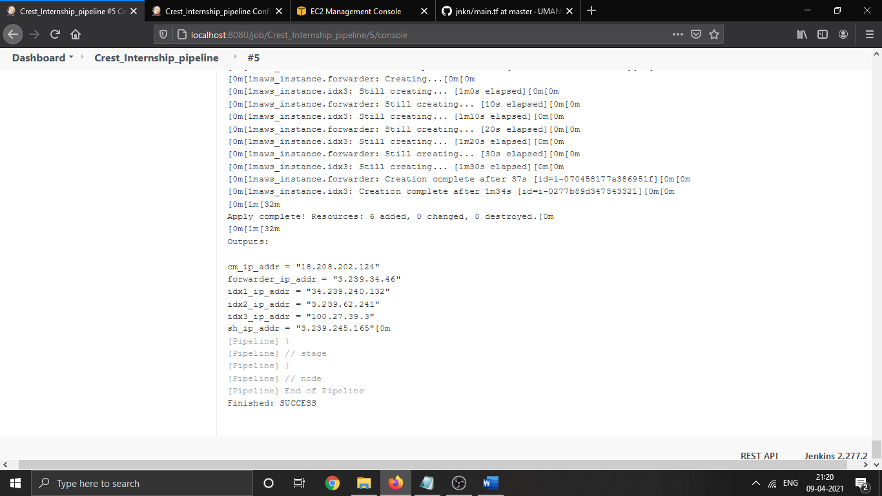
Console output of Jenkins triggered
Pipeline Ran Successful

Slide 14
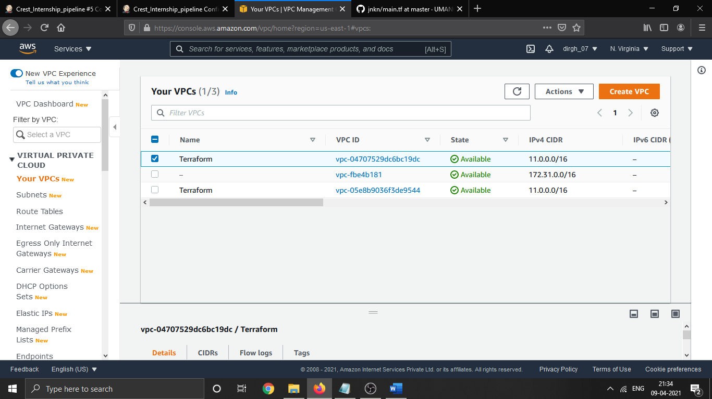
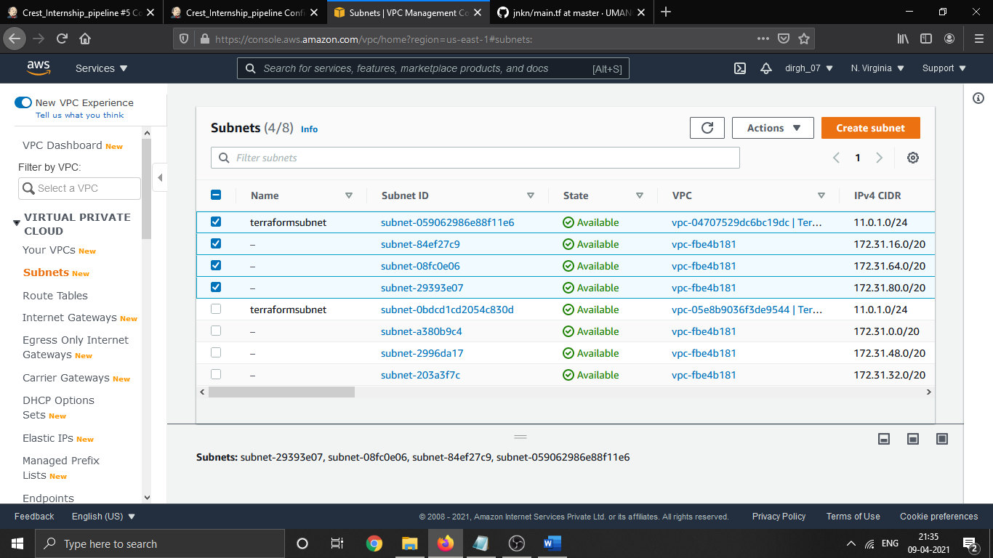
VPC Created
Subnet Formed

Slide 15
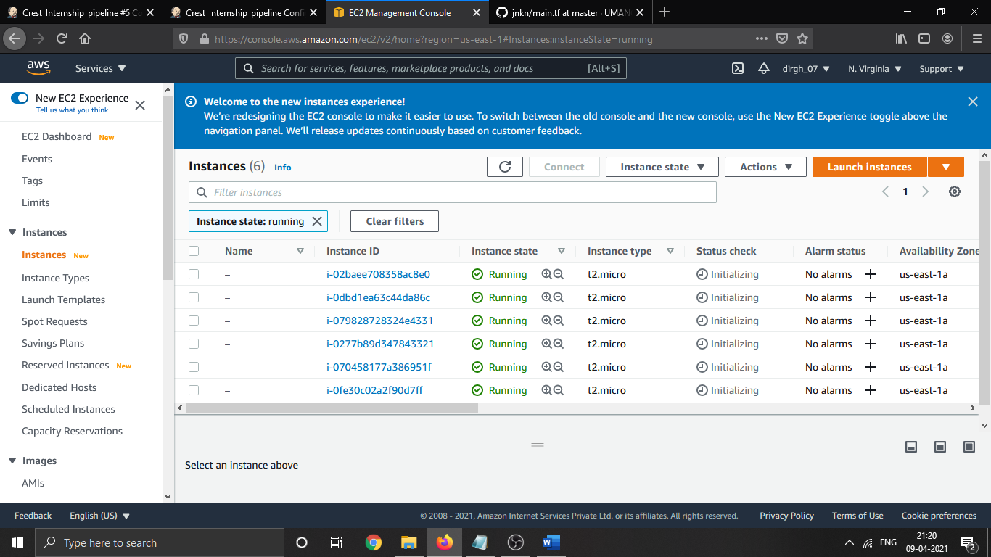
Instances Spawned on AWS

Slide 16
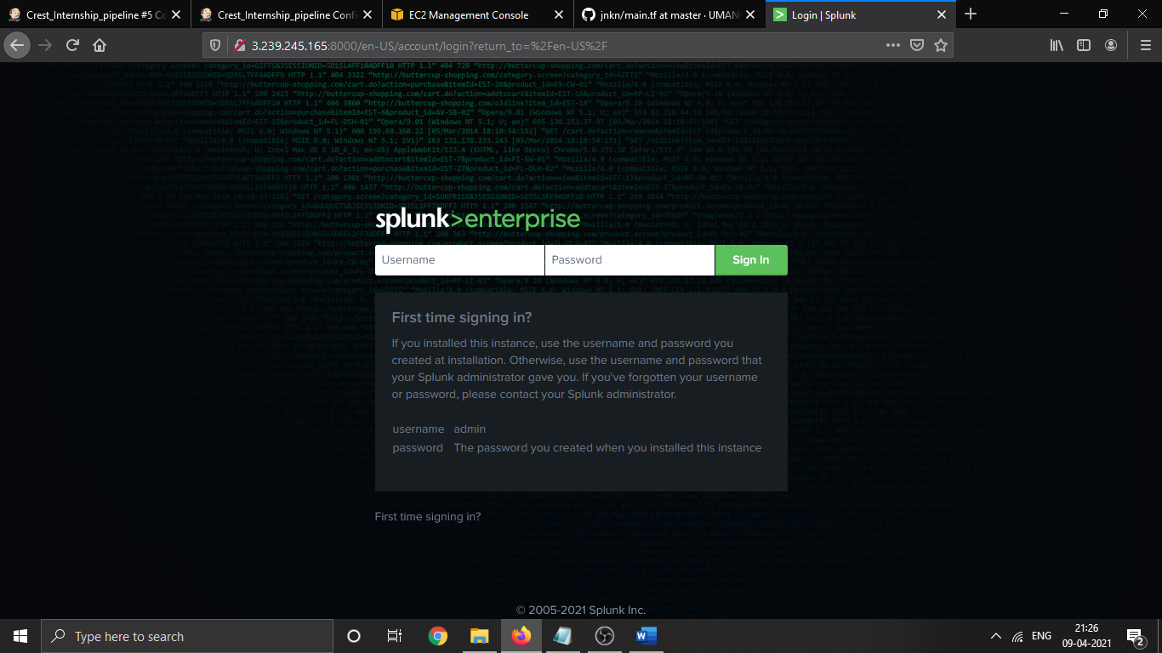
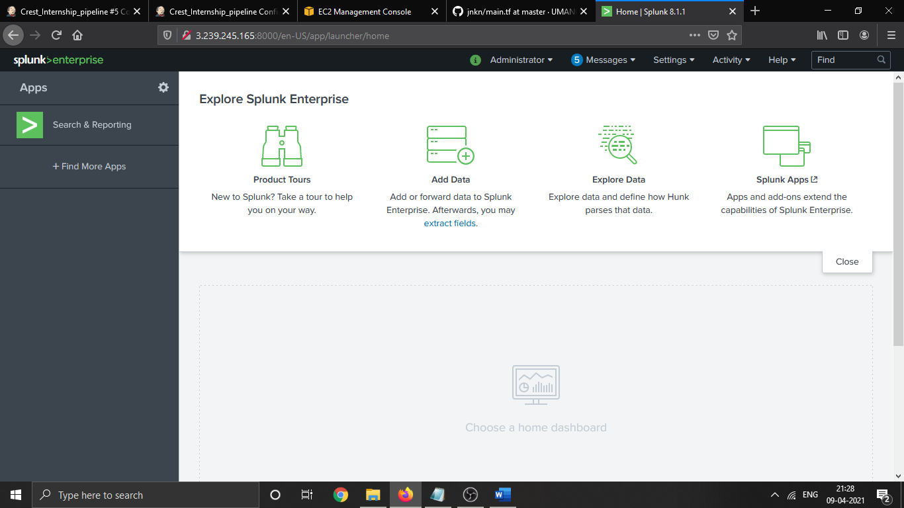
Splunk installed on the instance
spawned on AWS
UI could be accessed and no error message present/ no critical error

Slide 17
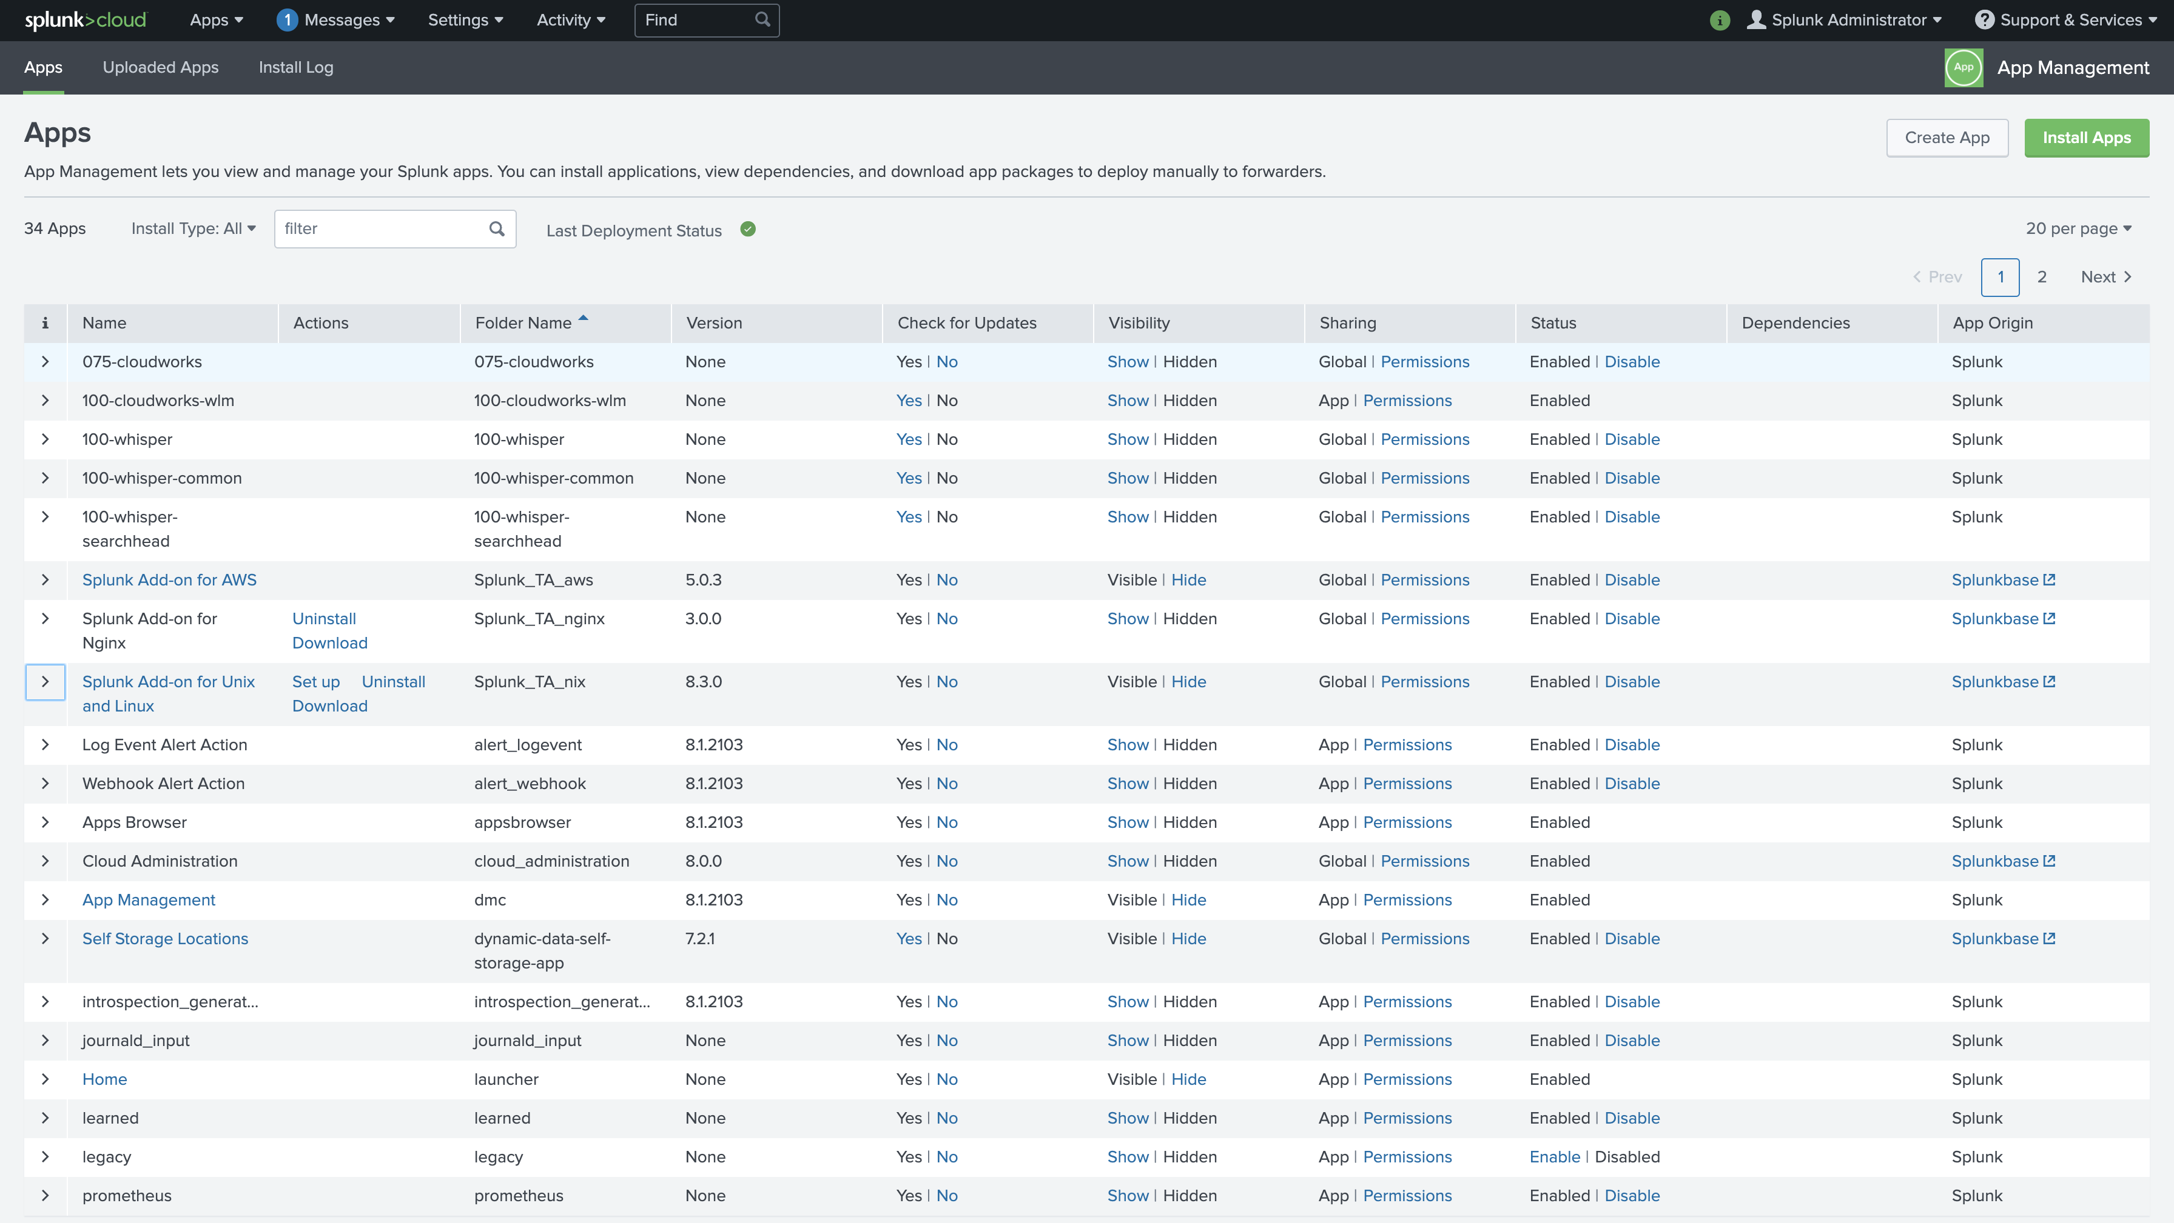
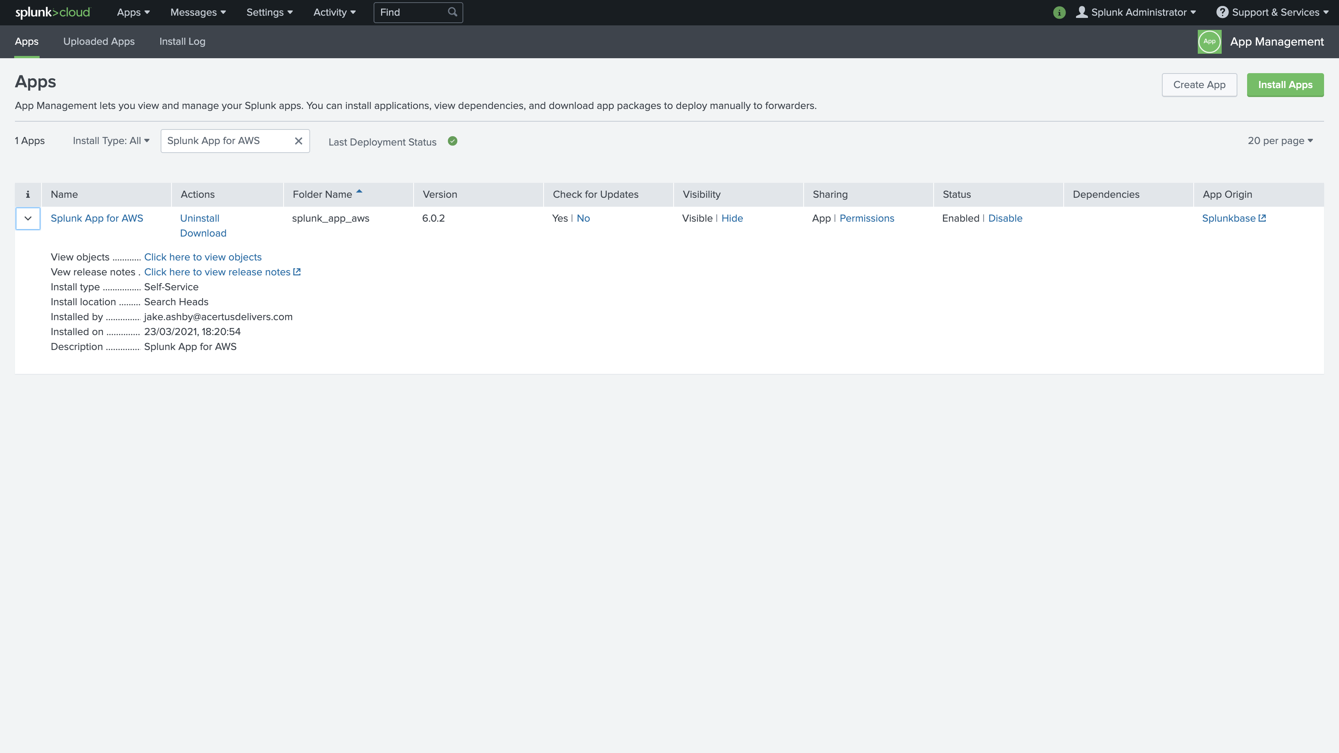
App Installed On Splunk Instance

Slide 18
Learning Outcome
We can easily manage configuration and deployment to remote machine. In this project changes have to be applied only at the workflows, and after the trigger, it gets deployed to the target server. Deploying a new code or any new splunk cluster architecture doesn’t have to be a heavy task. After creating a script (template), all work should be the automation of this workflow.

Slide 19
Future Planning
Currently the system has to be setup manually. Like we need to go to AWS console. Create multiple instances as per requirement of cluster. Install splunk and apps manually which is time consuming.

Slide 20
Thank You

